Slide 1
JS Crypt A Secured Chat Platform
by
Nitin Kumar (17414)
Shubham Jarotia (17416)
Aradhita Sharma (17421)
Shivansh Vashishtha (17466)
Under the supervision of​
Dr. Surender Soni
Associate Professor

Slide 2
Contents
Introduction
Problem Formulation
Literature Survey
Proposed System
Technology Stack
Methodology
Results
Conclusion
References

Slide 3
Introduction
This project proposes a secure chat platform for people to exchange their data over a secured network using cryptographic technique.
The aim is to develop a web application using JavaScript language, for making it user friendly.
This web app will provide a platform for confidential messages, and can be used for defense purposes.

Slide 4
Problem Formulation
With the increase in online social platform popularity, there is a need to secure all the mechanisms of data exchange.
Since the security and privacy of a user is the main concern, chat applications with a secure platform is in demand.
Data should be made accessible in a way that security should be shielded and assurance is incredibly examined. [1]
The system proposed to secure sensitive data is based on Advanced Encryption Standard (AES), which scrambles sensitive data using mathematical calculations to turn data into code.

Slide 5






Unauthorized Person
Unauthorized Person
Unencrypted Message
Cloud / Server
User 2
User 1

Slide 6
Literature Survey
Traditionally, all chat platforms preferred to share information over a network as it is, creating loop holes for data leakage. For confidential messages, various codes such as caeser cipher, morse code and many more were used. But the use of these codes for sharing secret messages did not reach upto the mark.
There were issues of data breaching since these codes were easy to decode by the persons knowing how to decode them. Hence, there was a need of a cryptographic system to cipher information or data in order to achieve confidentiality of the information in a way that an unauthorized person would be unable to derive its meaning, ruling out the possibility of data breaching.

Slide 7
In cryptography, the concealed information is usually termed plain text, and the process of disguising the plain text is defined as “encryption”, the encrypted plain text is known as cipher text. The encryption process relies on an encryption key, which is then give to the encryption algorithm as input along with the information. Using a decryption algorithm, the receiving side can retrieve the information using the appropriate “decryption key. Cryptography process seeks to distribute an estimation of basic cryptographic primitives across a number of confluences in order to reduce security assumptions on individual nodes, which establish a level of fault-tolerance opposing to the node alteration. [1]
AES algorithm provides confidentiality by block cipher modes by adding a key to the data as well as many rounds of substituting and transposing it using complex mathematical formulas. These algorithms make the final cipher text look completely alien from the data that it’s supposed to represent. Only authorized users that possess the key can decrypt the entire encrypted text sequence. AES encryption algorithm produces very good encryption results focusing towards the security against statistical attacks. [2]

Slide 8
Proposed System
Text Encryption : The aim is to implement Text encryption in chat application that encrypts all messages between participants rather than sending messages in clear text over the server. When app transmit sensitive or critical information over the network (private or public), it needs to encrypt the information to ensure information security.
File Transfer Encryption : The aim is to develop a simple file transfer system in chat app that can obtain privacy, integrity and authentication for the file transfer process. File transfer encryption helps in preventing information gathering during a data transfer, from being able to read and understand what’s being transferred. This kind of encryption is accomplished by scrambling the data into a non-human readable format, and then decrypting it back to a readable form once it has reached its destination.

Slide 9
ChatRooms : The aim is to develop a platform where a group of people can communicate with each other. Multiple people can join a particular conversation ranging from 2 to 10 number of users.
Multiple Rooms : The aim is to develop multiple rooms for multiple groups to chat at the same time. This means that, the web application can be used simultaneously all over the world, providing everyone a secure and private platform to transmit their data.
Maintainance of confidentiality : The aim is to provide a platform where there is no risk of data leakage from server side. No information will be saved in the database. This means that, even if anyone who has access to the server and the database will not be able to easily access user information. This rules out the idea of single point of failure which may cause a devastated damage in case of breaks in.

Slide 10





Technology Stack

Slide 11

Methodology

Slide 12
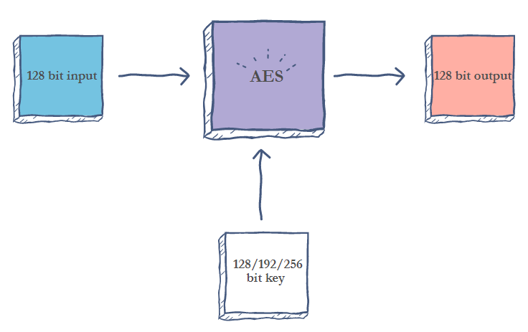
Advanced Encryption Standard (AES)
The AES algorithm (also known as the Rijndael algorithm) is a symmetrical block cipher algorithm that takes plain text in blocks of 128 bits and converts them to ciphertext using keys of 128, 192, and 256 bits. Since the AES algorithm is considered secure, it is in the worldwide standard.[2]

Slide 13
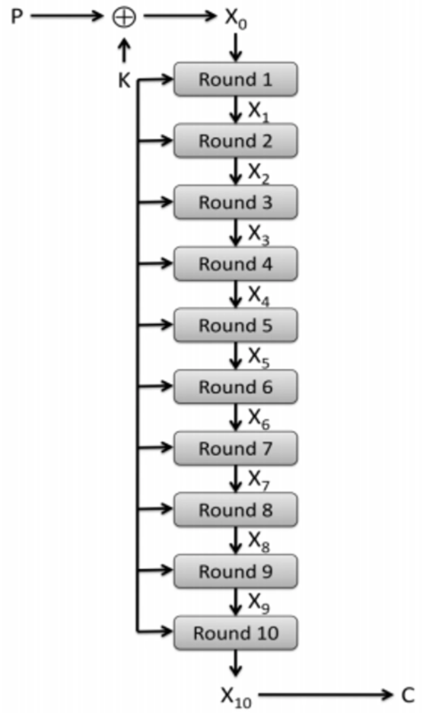
How does AES work?
The AES algorithm uses a substitution-permutation, or SP network, with multiple rounds to produce ciphertext. The number of rounds depends on the key size being used. A 128-bit key size dictates ten rounds, a 192-bit key size dictates 12 rounds, and a 258-bit key size has 14 rounds. Each of these rounds requires a round key, but since only one key is inputted into the algorithm, this key needs to be expanded to get keys for each round, including round 0.
In present day cryptography, AES is widely adopted and supported in both hardware and software. Till date, no practical cryptanalytic attacks against AES has been discovered. Additionally, AES has built-in flexibility of key length, which allows a degree of 'future-proofing' against progress in the ability to perform exhaustive key searches

Slide 14
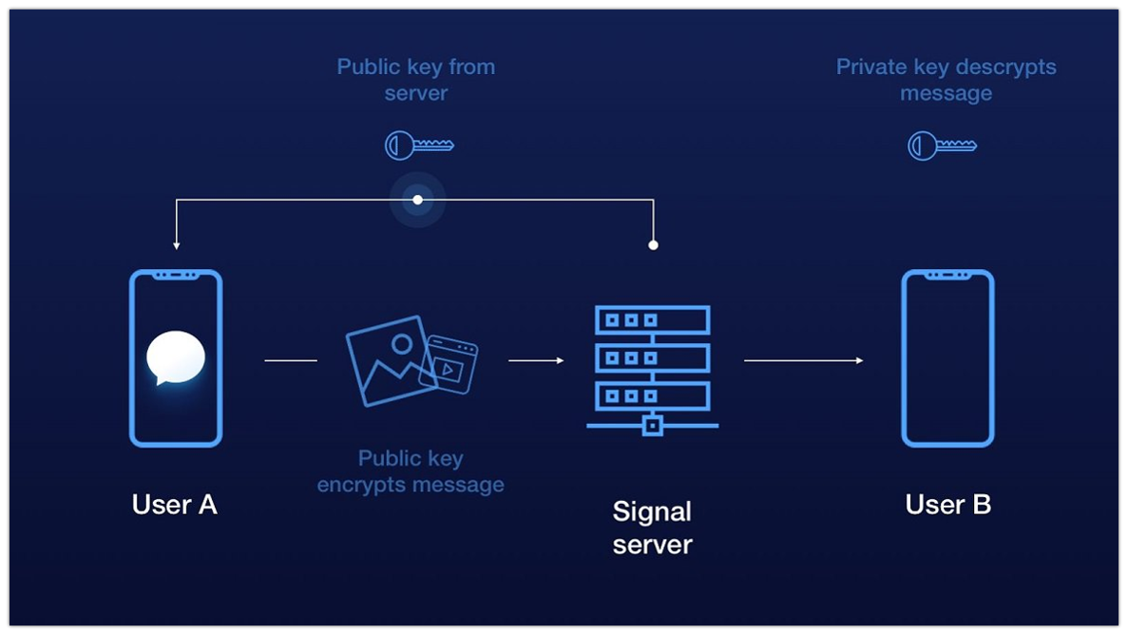

Slide 15
Socket Programming
For data transmission, Socket communication will be used. Socket programming is a way of connecting two nodes on a network to communicate with each other. One socket (node) listens on a particular port at an IP, while other socket reaches out to the other to form a connection. Server forms the listener socket while client reaches out to the server.
In this project, Socket.IO will be used mainly for server and client interaction. Socket.IO is a JavaScript library for real-time web applications. A real-time application (RTA) is an application that functions within a period that the user senses as immediate or current. There is no need to refresh website to receive new messages in case of chat apps.

Slide 16
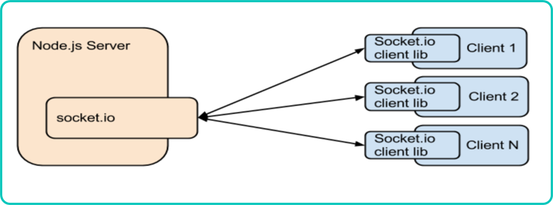
Socket.IO enables real-time, bi-directional communication between web clients and servers. It has two parts:​
a client-side library that runs in the browser ​
a server-side library for node.js​
The server can push messages to clients. Whenever an event occurs, the idea is that the server will get it and push it to the concerned connected clients​. [3]

Slide 17
Encrypted Chat
This project aims to build an encrypted chat platform for different groups of people with no fear of data leakage.
For this, CryptoJS library will be used. CryptoJS is a growing collection of standard and secure cryptographic algorithms implemented in JavaScript using best practices and patterns, by storing the messages in the form of hash functions.
A cryptographic hash function is an algorithm that takes an arbitrary amount of data input—a credential—and produces a fixed-size output of enciphered text called a hash value, or just “hash”.

Slide 18
Encrypted file sharing with AES
The second feature of this project will be the encryption of file sharing process. AES is the secure method for file sharing and data transfers.
When any client will upload a file, an encrypted link is generated in chat for downloading, eliminating the possibility of data leakage. Hence the file sharing will be done in a secure way. [4]

Slide 19
Chat room Functionality
Ranging from one to one communication, to many to many communication, this project aims to include every feature.
Multiple users can connect with the server, and server will connect them to the other users present in that chat room.
This can be achieved using socket programming, by exchanging the data through a particular port.

Slide 20
Multiple room availability
This project aims to build a platform that can be used worldwide, not just by a group. For that, a multiple room feature will be embedded.
Users will enter their respective rooms and every data shared in one room will remain in that room until everyone leaves the room.
Multiple room availability for the users will be implemented by Socket.IO library.

Slide 21
Confidentiality maintainance
The main aim of this project is to provide confidentiality.
Cryptographic techniques are used to secure information from unwanted persons to intrude via internet. But this project aims to provide security from server side too.
No data will be stored in server side’s data base, such that confidentiality of information of users is achieved.

Slide 22
Result

Slide 23
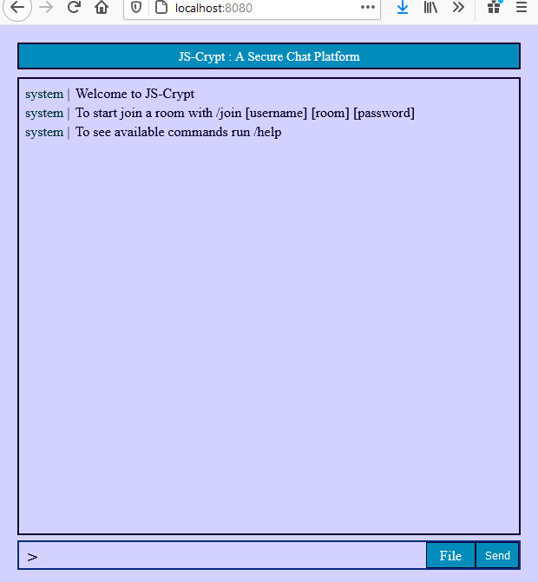
Web Application

Slide 24
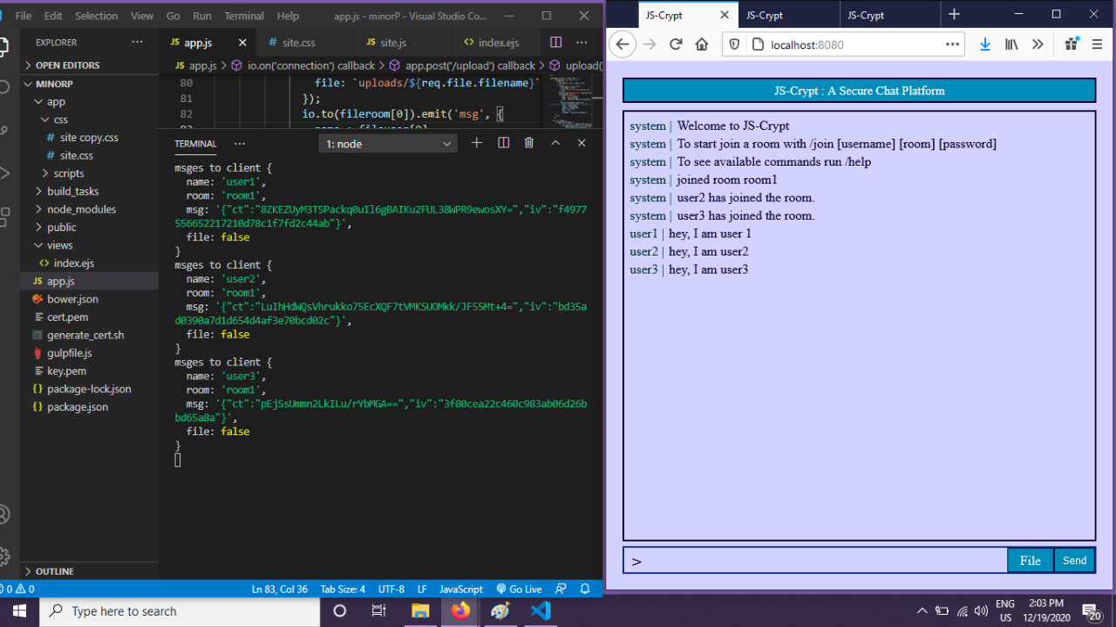
Encrypted text exchange

Slide 25
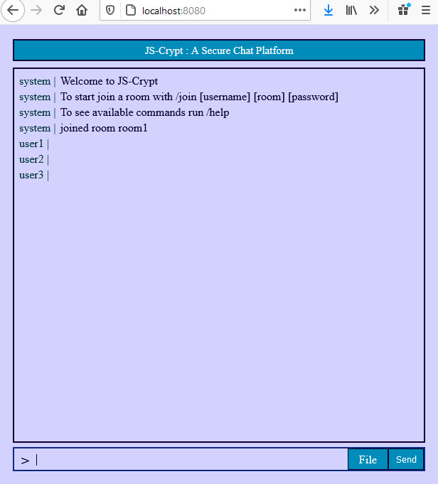
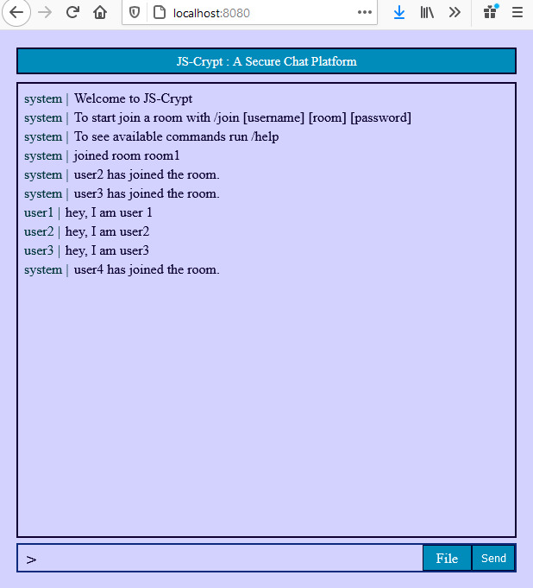
No data leakage for outsider user

Slide 26
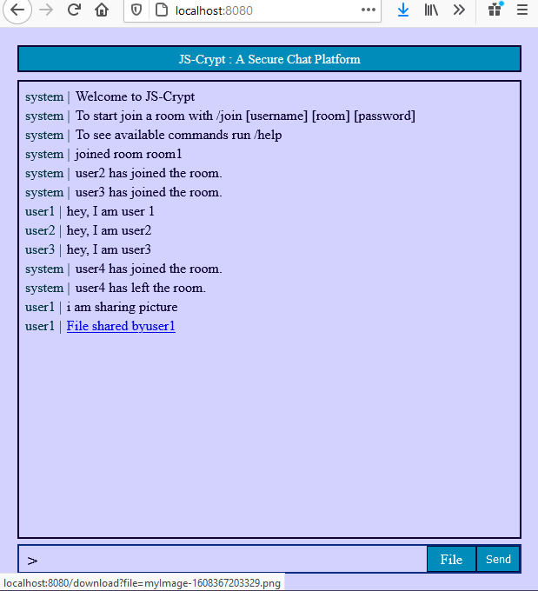
File sharing

Slide 27

Conclusion
The idea of the project is to build a lightweight server/client platform that can be run and utilized on hardware and software combination.
To give people the opportunity to have their own encrypted chat networks.
Privacy is a human right and extends to everyone in this world, and as such people should have access to a free way to ensure that right is upheld.

Slide 28
Future Scope
In future research, this application with the text chat service could be extended to an encrypted voice and video chat service.
Moreover, this project can be extended to android application for better reach and scalability and performance of the chat server can be modified.

Slide 29
References
[1] D. K. Senthil Kumar N, Saravanakumar K, “On privacy and security in social me-dia – a comprehensive study,” inInternational Conference on Information SecurityPrivacy (ICISP2015), 2016, p. 114 – 119.
[2] Ashwak M. AL-Abiachi, Faudziah Ahmad and Ku Ruhan (2011). "A Competitive Study of Cryptography Techniques over Block Cipher " 13th International Conference on Modelling and Simulation. DOI 10.1109/UKSIM.2011.85
[3] J. J. L. Shu Man Zhao, Xiao Ling Xia, “A real-time web application solution based on node.js and websocket,” inAdvanced Materials Research, 2013.
[4] Kundankumar Rameshwar Saraf, Vishal Prakash Jagtap, and Amit Kumar Mishra (2014). "Text and Image Encryption Decryption Using Advanced Encryption Standard". International Journal of Emerging Trends Technology in Computer Science (IJETTCS). ISSN 2278-6856

Slide 30
Thank You

